Slide 1



Session 1.2: Advanced Prompting
& Structured Outputs
Treating Prompt Engineering as a Formal Programming Discipline

Slide 2
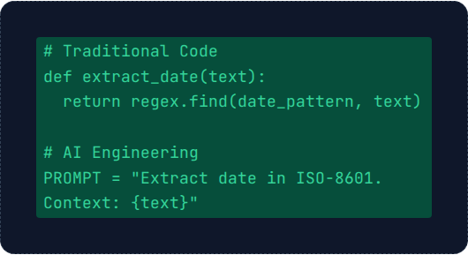
The Engineering Mindset
Prompting is NOT Chatting
In the enterprise, a prompt is the source code that programs the LLM's behavior.
Vague Input = Broken Pipeline: Auto-regressive decoding will wander without constraints.
Deterministic Results: The goal is consistent, predictable data extraction.

Slide 3


Role Prompting: Setting Boundaries
By defining a persona, you narrow the mathematical probability of word choices.
Weak Prompt
Strong Prompt
"Check this contract for errors."
"Act as a Senior Legal Counsel specializing in corporate law. Review this contract for liability loopholes."
Result: Generates casual, generic feedback.
Result: Uses industry terminology and professional logic.
Persona is the cheapest way to improve output quality instantly.

Slide 4




The 'Shot' Framework
Zero-Shot
One-Shot
Few-Shot
No examples provided.
One perfect example.
3-5 high-quality examples.
"Classify this review: 'The UI is clunky.'"
"Input: 'Love it!' -> Positive. Input: 'Clunky UI' -> ?"
Establishes a powerful pattern for niche, complex tasks.
Mantis Rule: More shots = Higher accuracy but Higher cost (tokens). Find the sweet spot.

Slide 5

Reasoning: Chain-of-Thought (CoT)
Step-by-Step Reasoning:
The Logic Puzzle
Uses "Scratchpad Memory" to store intermediate facts.
"A farmer has 15 sheep. All but 8 die. How many are left?"
Forces the model to generate the path to the answer.
Standard AI: "7" (Wrong subtraction)
CoT AI: "If all but 8 die, then 8 survived. Answer: 8."
Command: "Think step-by-step."

Slide 6






Reliability: Self-Consistency
Ask the same question multiple times (Higher Temp) and take the Majority Vote.
Critical for Healthcare, Finance, & Legal. We trade compute cost for perfect accuracy.

Slide 7
Mega-Prompt Anatomy
Persona: "You are an expert corporate data auditor..."
Context: "We are processing raw text from corporate PDFs..."
Task: "Extract the Title, Author, and a 1-sentence Summary."
Guardrails: "If author is missing, output 'UNKNOWN'. Do not guess."
Few-Shot: 2-3 input/output pairs to demonstrate the rules.

Slide 8
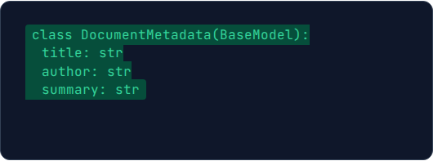
The JSON Revolution
Software Needs Structure
AI text is unpredictable. Python code crashes if format changes.
Pydantic: Strict data blueprints.
→ Guaranteed JSON response every time.
Instructor: Forces Gemini to obey the schema.

Slide 9






Lab: Building the Pipeline
Compare Shots
Reasoning Lab
JSON Extraction
See the difference between Zero and Few-shot extraction speed and accuracy.
Trigger CoT to solve complex logic and see the "thought process" logs.
Use Instructor to pull structured metadata directly into Python variables.

Slide 10
Summary
Mastered Role Prompting and the Shot Framework.
Implemented reasoning via CoT and Self-Consistency.
Built deterministic JSON pipelines with Pydantic.
Session 1.2 Complete. Questions?

